Slide 1
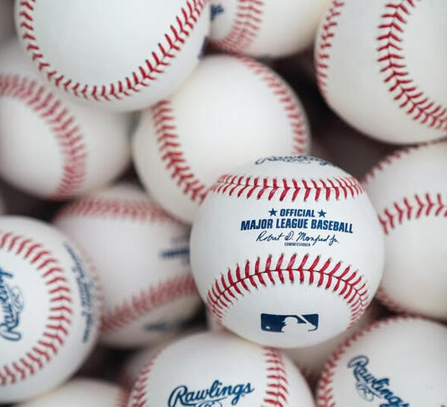
Bill James: The Pioneer of Sabermetrics
By: Graydon Bower

Slide 2
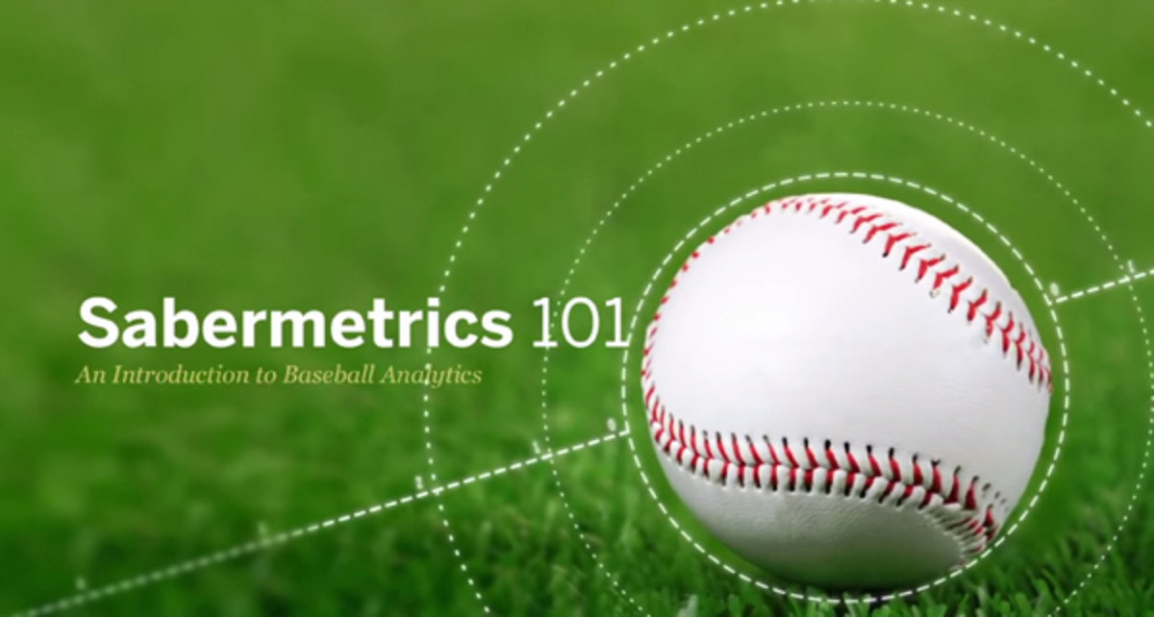
What is Sabermetrics?
Sabermetrics = statistical analysis of baseball
Attempts to quantify performance through statistical means and previous records
Has led to development of quantifiable player performance metrics
Many metrics developed through sabermetrics arose as challenges to traditional statistics
Term was first coined by Bill James
First sabermetrician to gain large following
Named after Society for American Baseball Research (SABER)

Slide 3
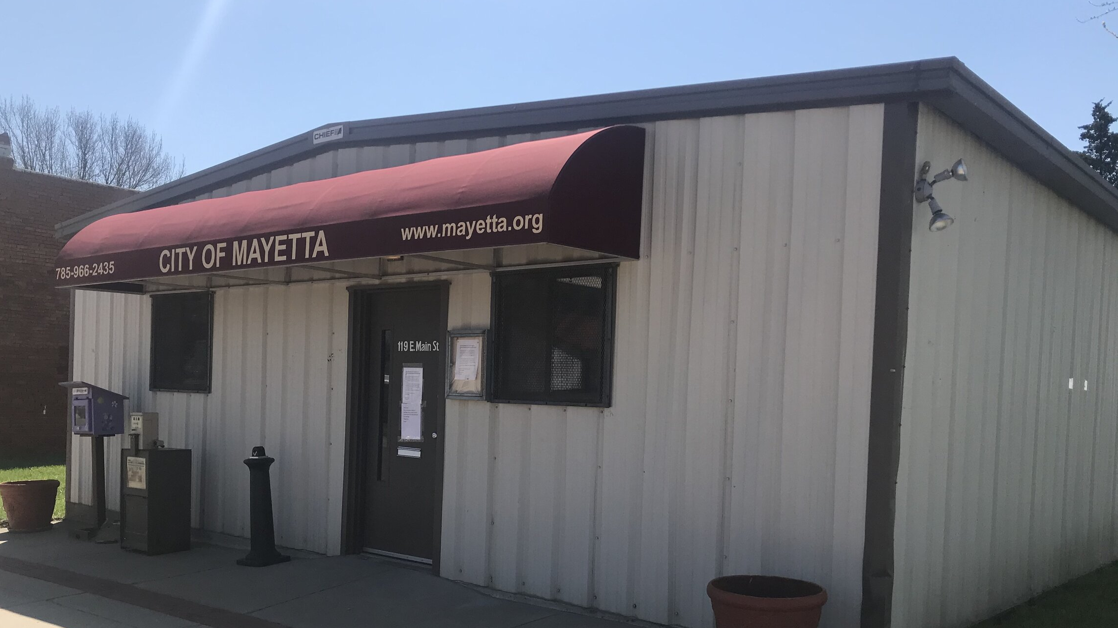
Early Life
Born in 1949 in Holton, KS
Raised in small town of Mayetta, KS (only 300 people)
His mother died when he was five
His father was a janitor and handyman
Avid reader who spent significant time in his own thoughts
Huge baseball fan (specifically of the Kansas City A’s)

Slide 4

College Life
Attended University of Kansas from 1967 to 1973
Spent 2 years serving the Army in Vietnam War from 1971 to 1973
Double-majored in English and Economics in 1973
Finished another degree in Education in 1975

Slide 5

Beginning of Writing Career
Joined Society for American Baseball Research (SABR) in 1974
Got part-time job working as security guard at the Stokely-Van Camp Pork and Beans Cannery to make ends meet
Began writing about baseball while working at the Cannery
Examined baseball through guise of a scientist
Typically posed questions in his articles and presented data and analysis to answer them
Ex: “Who are the fastest runners in the MLB?”

Slide 6
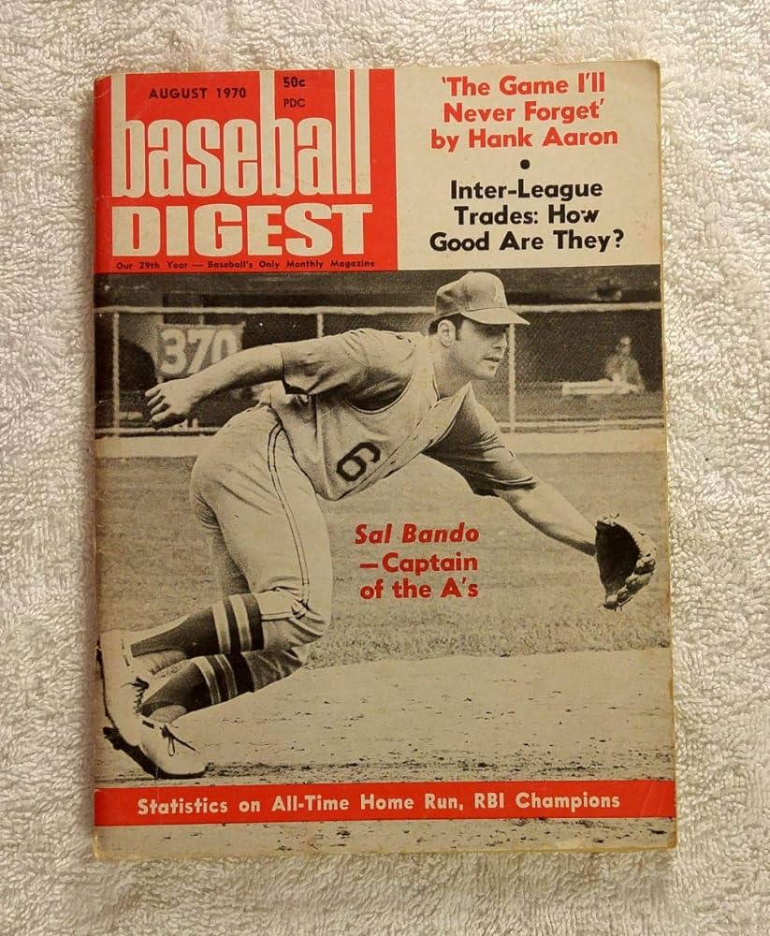
Initial Challenges Faced
Sent first pieces to various sports magazines
His works were considered unusual
Publications felt readers would have to study understand them
Felt their main purpose was entertainment, not science

Slide 7
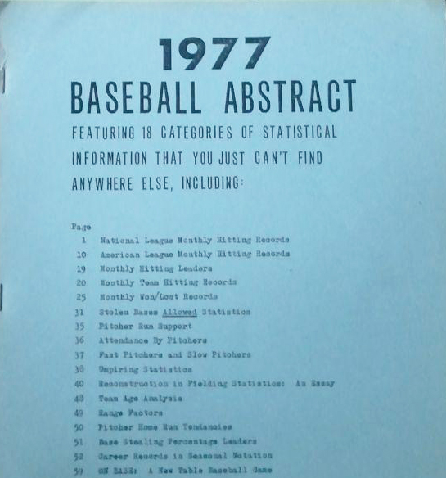
Self-Published Work
Challenges in getting his works published led James to self-publish articles
Decided to self-publish annual book called The Bill James Baseball Abstract (1st edition published in 1977)
Sold only 75 copies
Abstract's contained in-depth studies and statistics from study of box scores and The Baseball Encyclopedia
1978’s edition sold 250 copies
These figures continued to grow over time

Slide 8
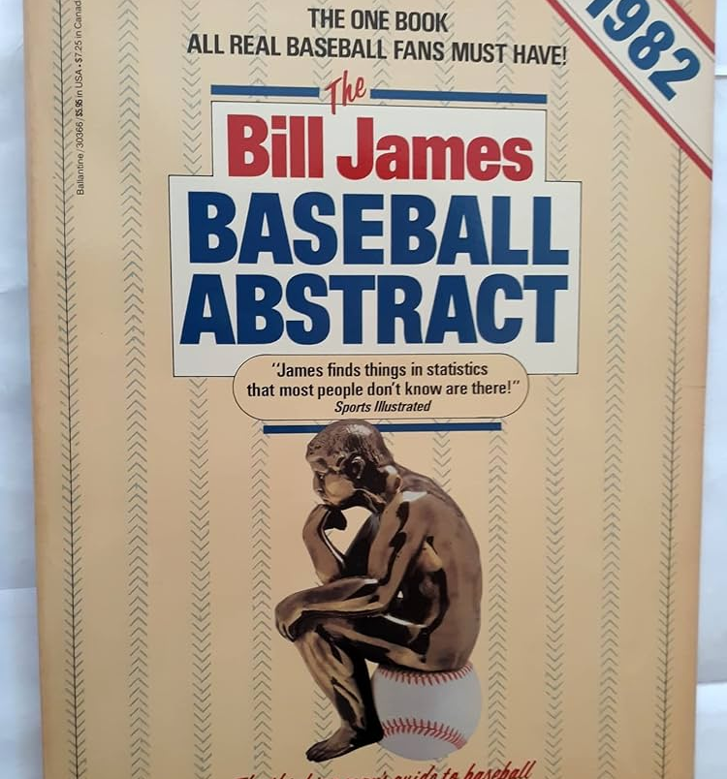
Rise to Fame
Sport Illustrated wrote profile on him which thrust him into spotlight
Baseball Abstract’s started becoming very popular in the 80s
1981’s copy of Abstract sold so well that a major publisher began producing it in 1982
His success with the Abstract allowed him to quit his security job and pursue writing full-time
This annual was discontinued in 1988
Has continued to publish other books and articles through present

Slide 9

Critics Within MLB
Had many critics within the MLB (mainly coaches, GM’s and scouts)
Rejected his ideas because they challenged traditional and established statistics
MLB wasn’t very open to intellectuals at time
Claimed he was attacking the sport
Believed he didn’t possess the knowledge and experience of Major League veterans

Slide 10
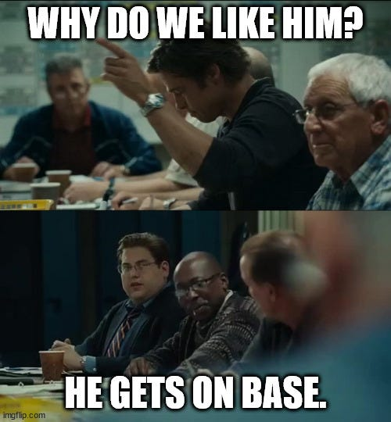
Moneyball and the Beginning of the Sabermetrics Era
Oakland A’s were first major adopter of sabermetrics
In the early 2000’s, Billy Beane (the GM) used sabermetrics to build cost-effective but very successful team
Culminated in A’s making the playoffs from 2000 to 2003
Also won 20 consecutive games in 2002 (record in the AL)
Achieved this despite having low budget to spend on players
Inspired many other teams to hire sabermatricians and adopt James’s analytics

Slide 11
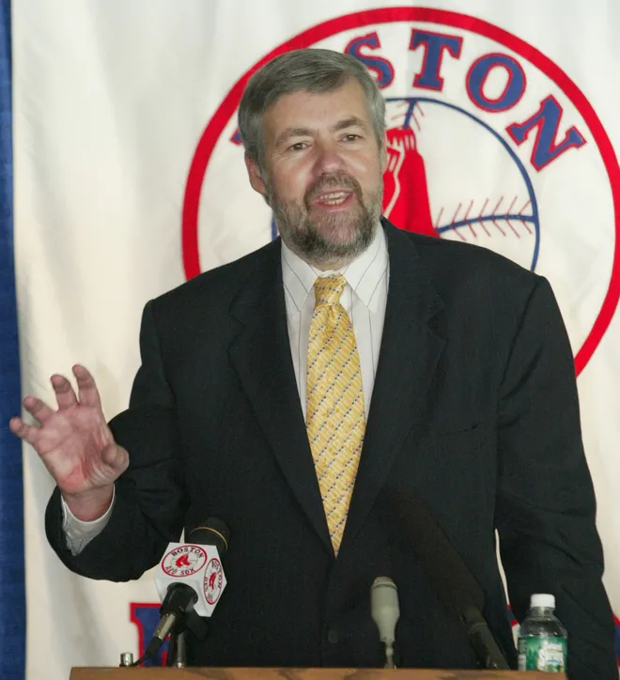
Working in Baseball
Was hired in 2003 as Boston Red Sox Senior Baseball Operations Advisor
Retired in 2019
Credited with endorsing moves that laid groundwork for team’s first World Series in 86 years
Placed emphasis on on-base percentage
Developed proprietary software system team utilized to evaluate players and make trades

Slide 12
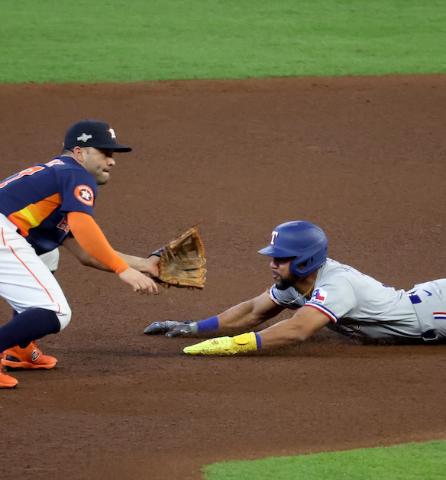
Famous Insights
Stealing bases does more harm than good
On-base percentage better than batting average as offensive indicator
Power hitters with low batting average better than players with high batting average
Strikeout-to-walk ratio best indicator of pitcher performance
Luck plays major role in pitcher wins
Importance of adjusting statistics for park factors
Best usage of closer is when the game is tied (even if that means before 9th inning)

Slide 13
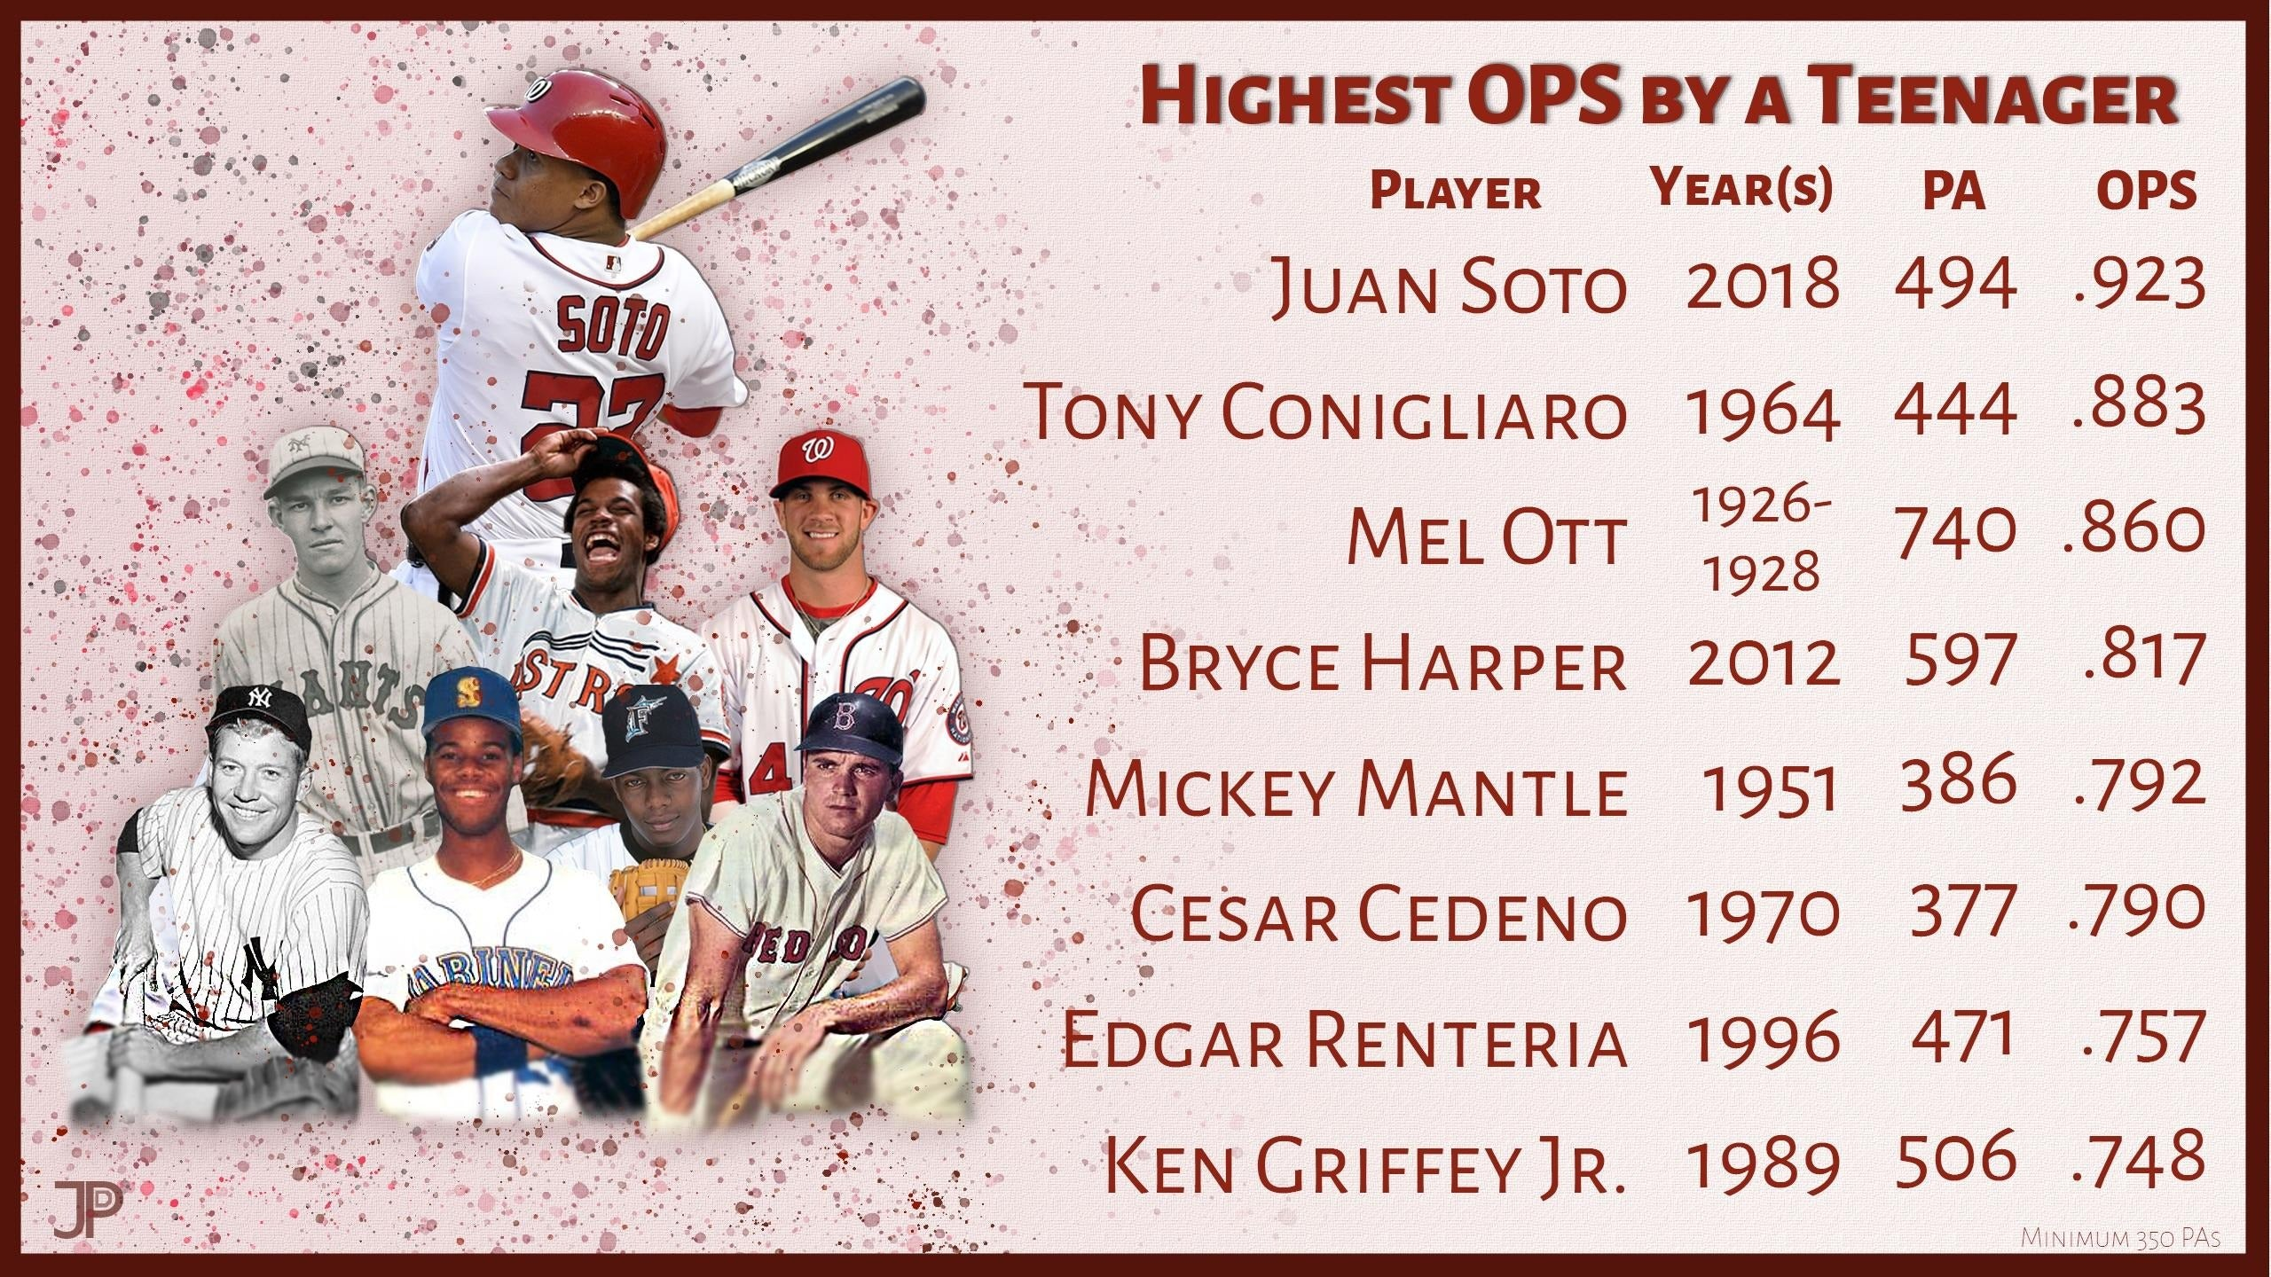
Statistical Advancements
Development of On-Base Plus Slugging (OPS) stat
Pythagorean Winning Percentage
Runs Created
Major League Equivalencies
Development of Wins Above Replacement stat
Similarity Scores
Range Factor

Slide 14
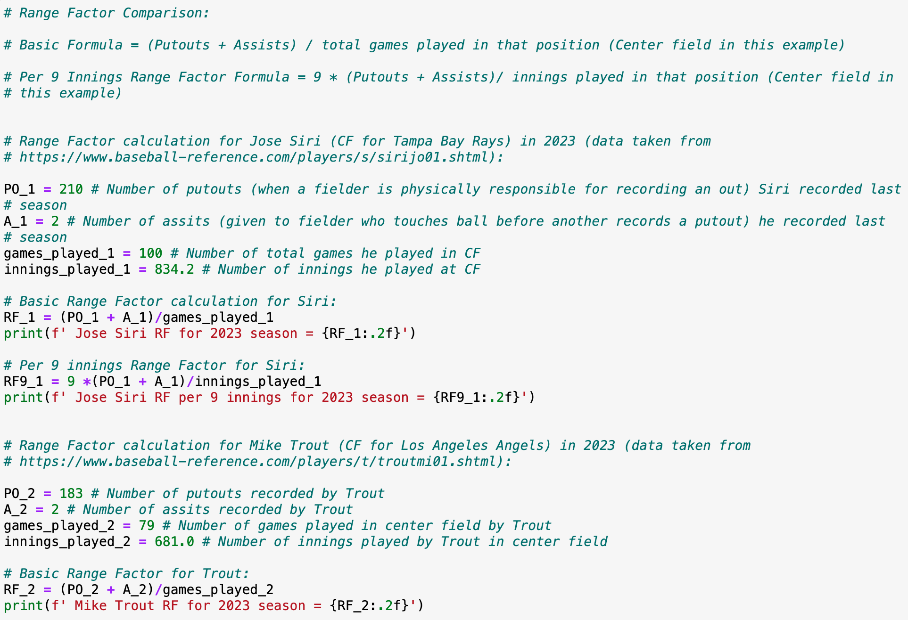
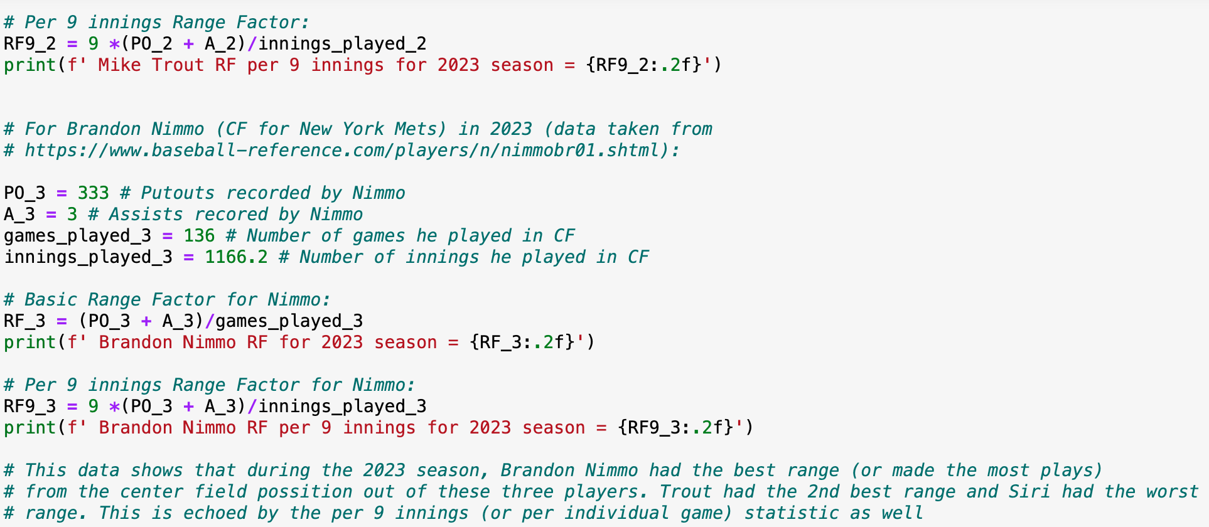
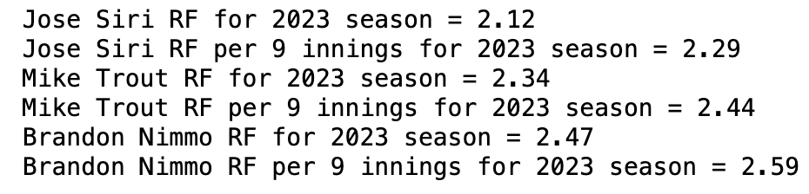
Range Factor Code Example

Slide 15
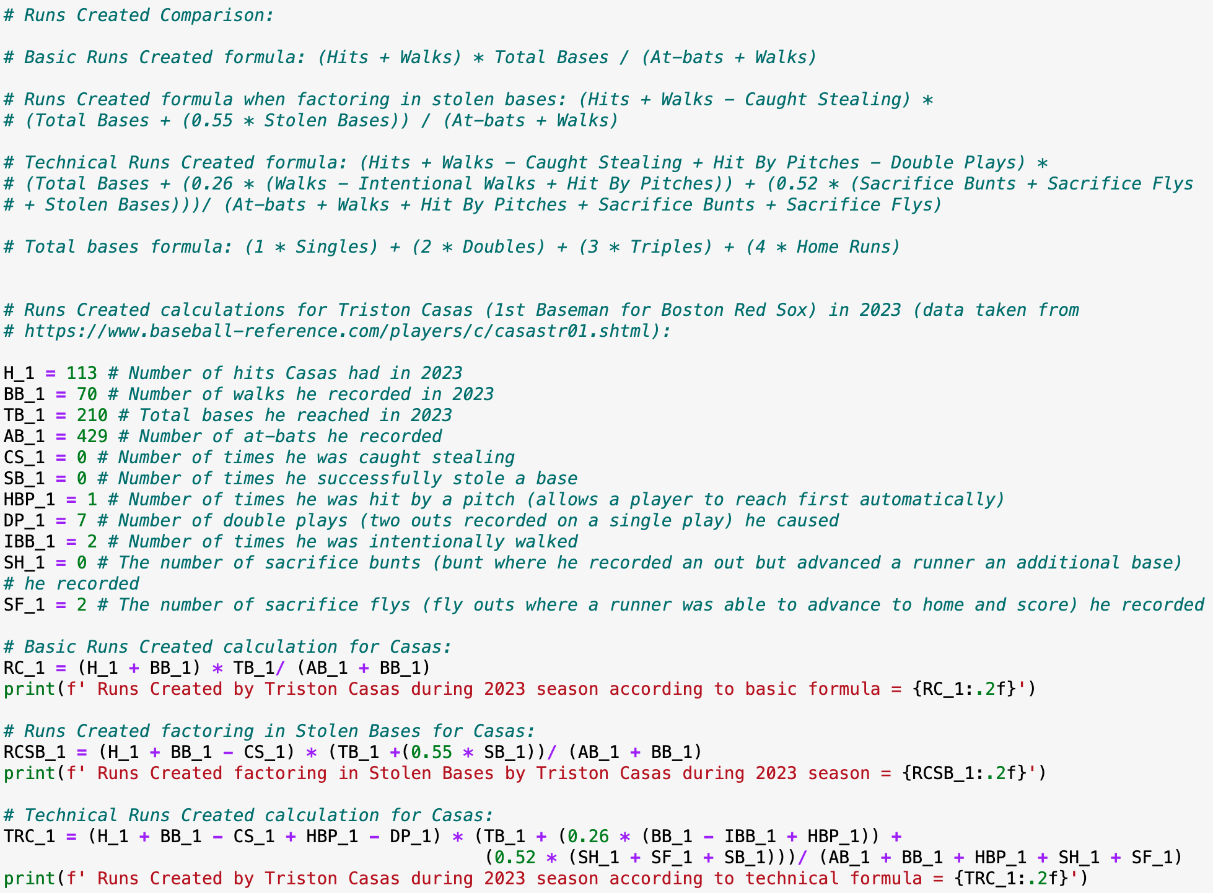
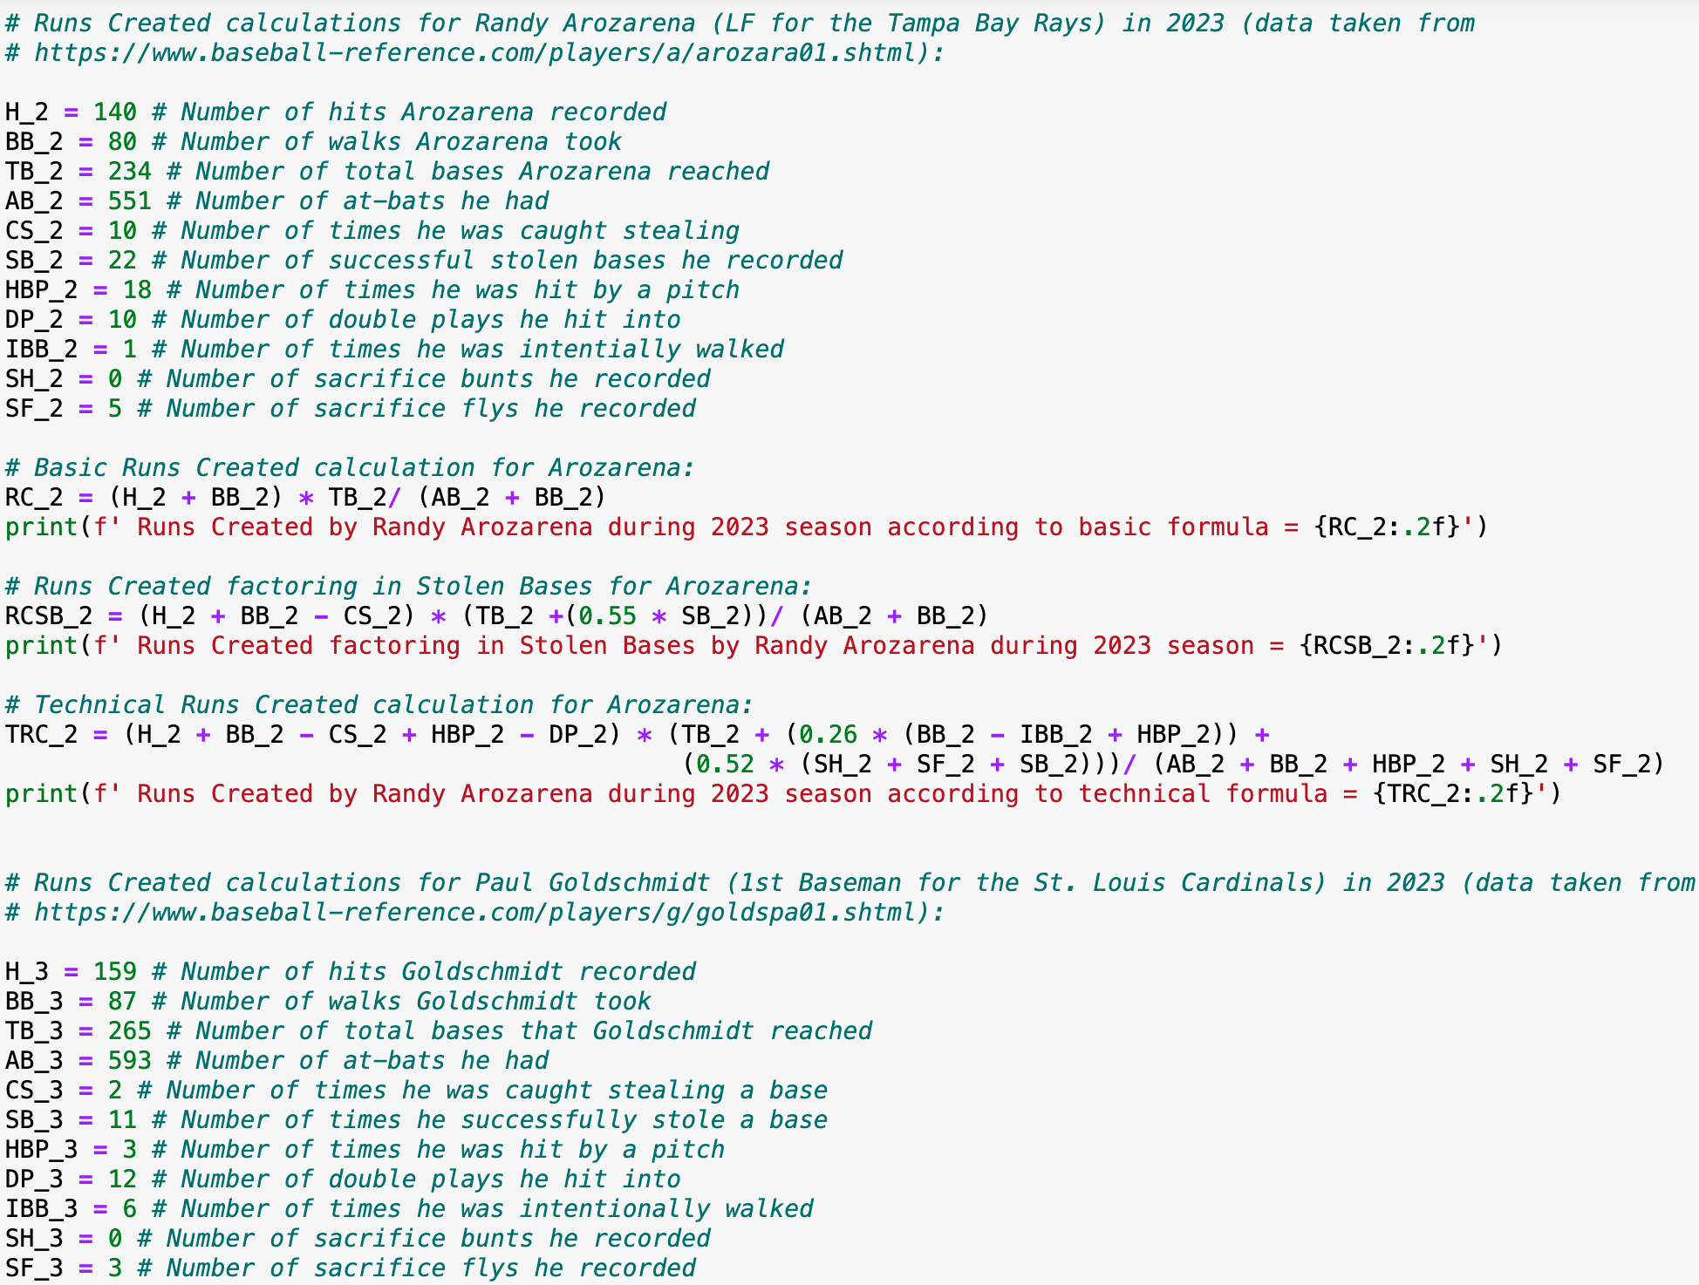
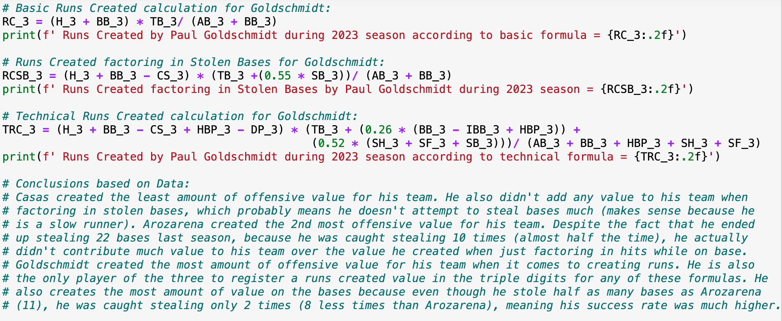
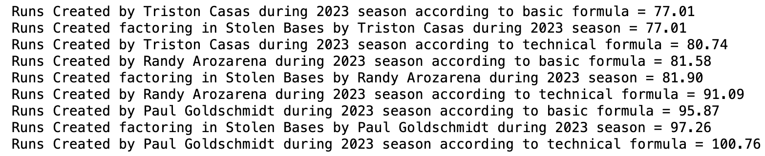
Runs Created Coding Example

Slide 16
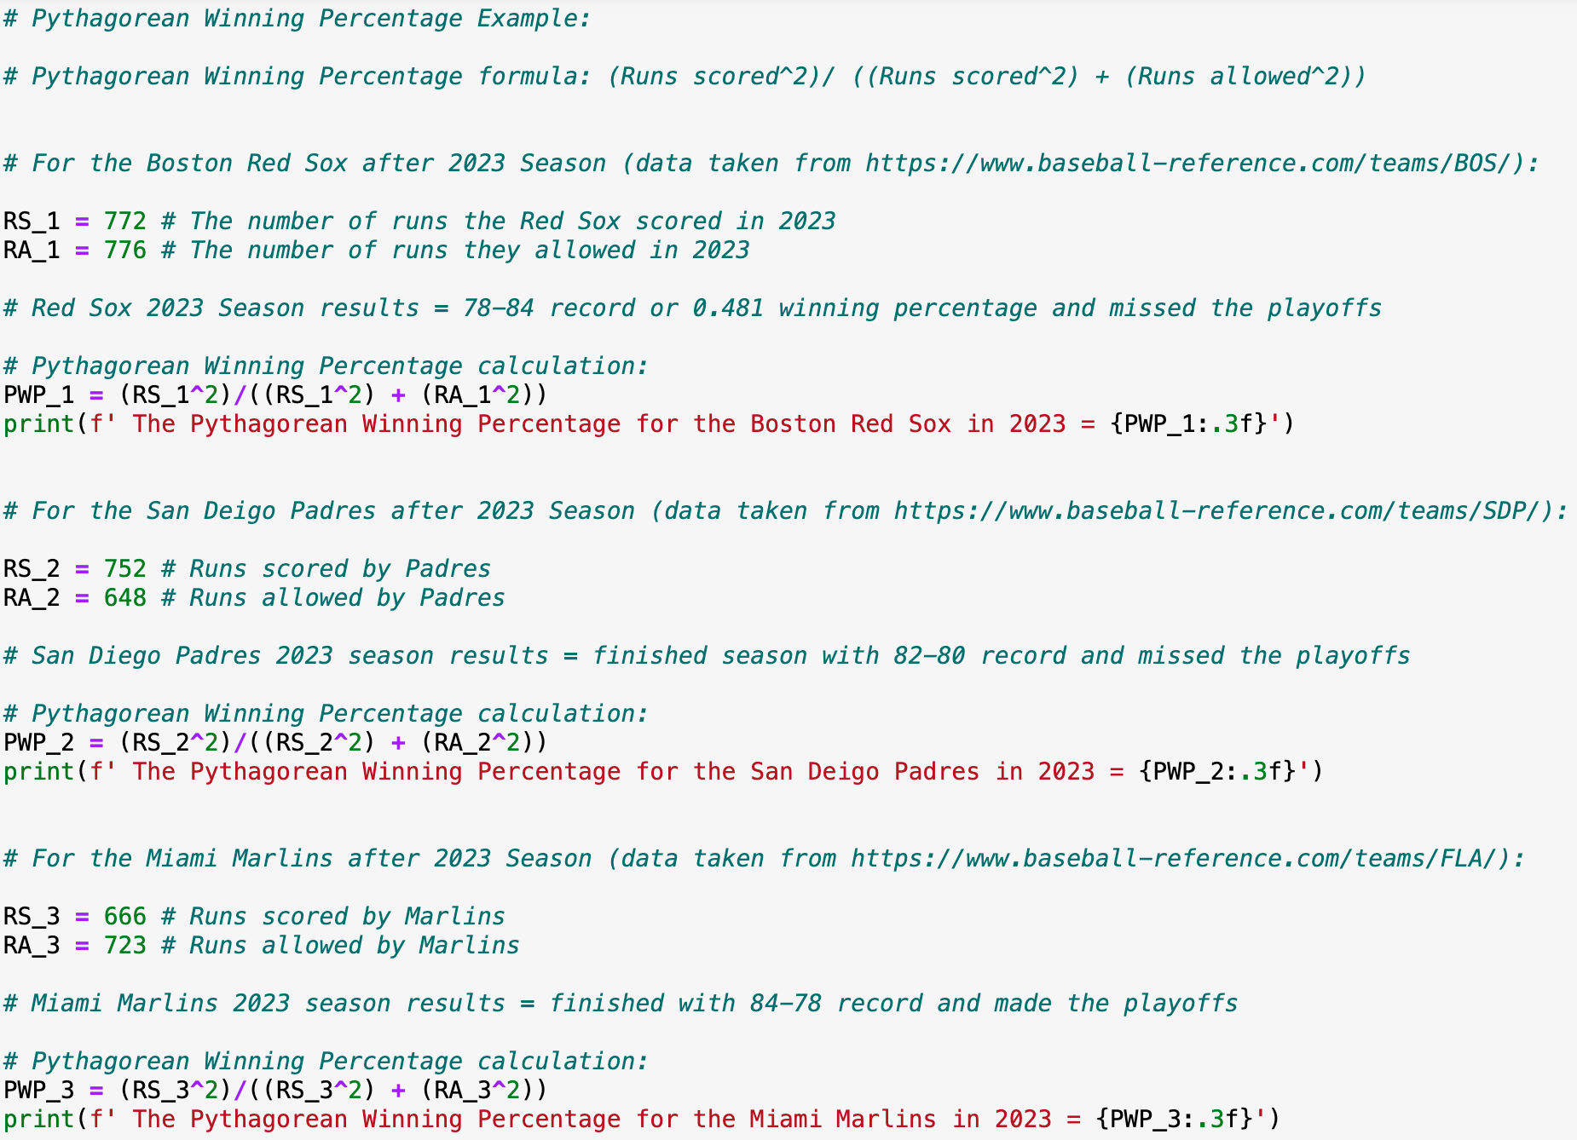
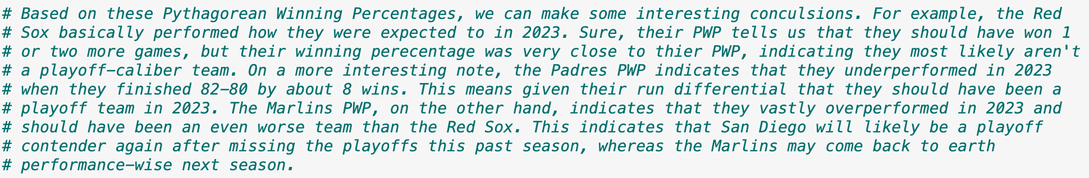
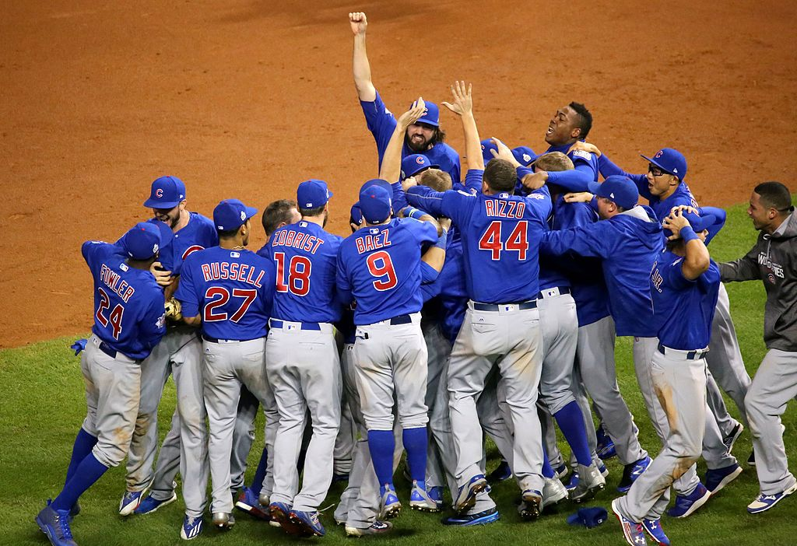
Pythagorean Winning Percentage Coding Example

Slide 17
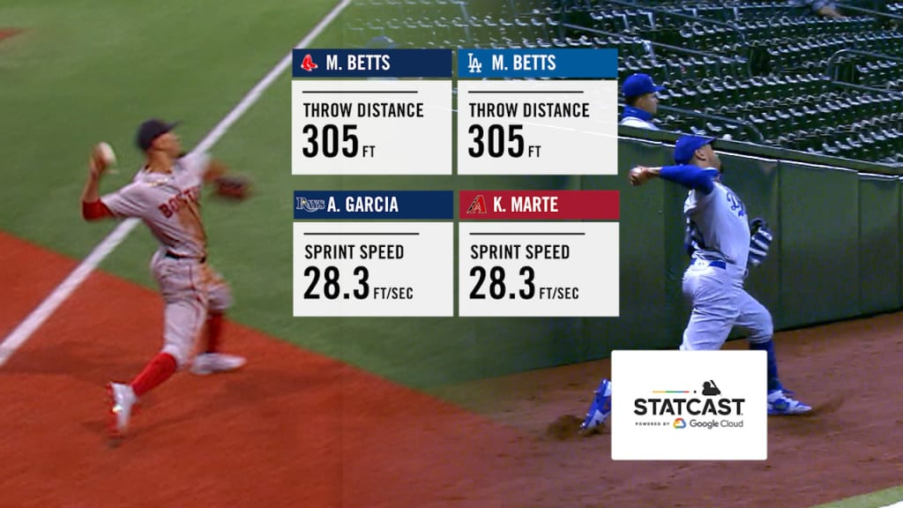
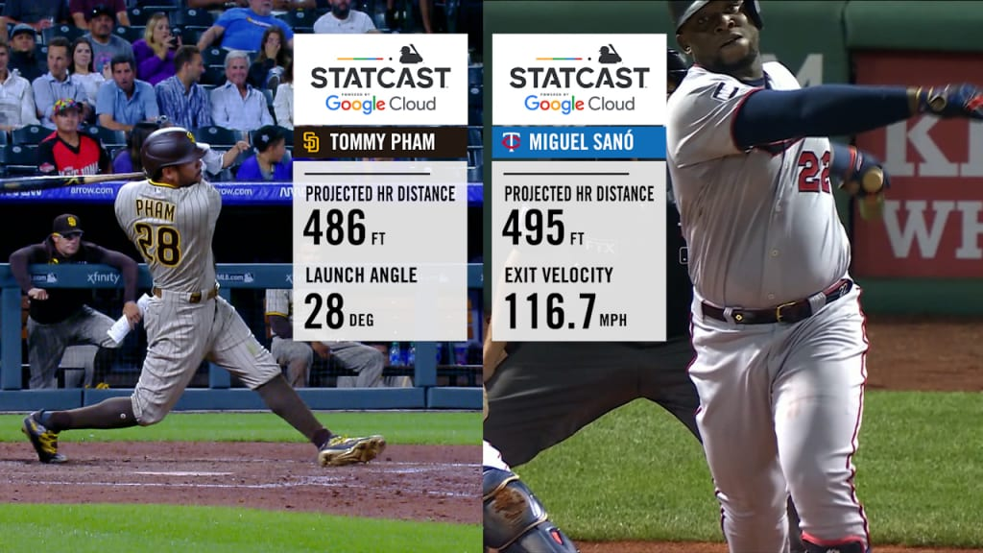
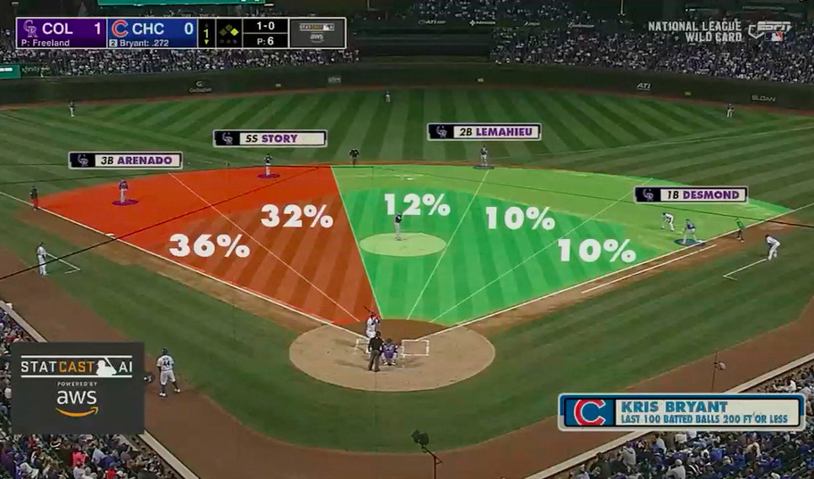
Lasting Impact
By 2012, all 30 MLB franchises employed at least one sabermatrician
Sabermetric revolution has placed increased emphasis on capturing increasing amount of data
Led to development of Statcast (camera tracking system that captures in-depth player performance data)
Statistical evolution of baseball traces back to James’s influence

Slide 18
References
Bill James Wikipedia Article
URL: https://en.wikipedia.org/wiki/Bill_James#:~:text=An%20aspiring%20writer%20and%20obsessive,Camp's%20pork%20and%20beans%20cannery
Bill James, the Sabermatrician
URL: https://medium.com/@andrewszanton/bill-james-the-sabermetrician-eba202854478
Sabermetrics
URL: https://www.britannica.com/sports/sabermetrics
Bill James: The Man Who Changed Sports Forever
URL: https://spacecoastdaily.com/2021/04/bill-james-the-man-who-changed-sports-forever/
Bill James Geniuses Article
URL: https://geniuses.club/genius/bill-james#google_vignette
Range Factor (RF)
URL: https://www.mlb.com/glossary/advanced-stats/range-factor
Runs Created (RC)
URL: https://www.mlb.com/glossary/advanced-stats/runs-created
Runs created
URL: https://en.wikipedia.org/wiki/Runs_created
Pythagorean Winning Percentage
URL: https://www.mlb.com/glossary/advanced-stats/pythagorean-winning-percentage

Slide 19
Data Used for Coding Examples
Jose Siri Baseball-Reference Page
URL: https://www.baseball-reference.com/players/s/sirijo01.shtml
Mike Trout Baseball-Reference Page
URL: https://www.baseball-reference.com/players/t/troutmi01.shtml
Brandon Nimmo Baseball-Reference Page
URL: https://www.baseball-reference.com/players/n/nimmobr01.shtml
Triston Casas Baseball-Reference Page
URL: https://www.baseball-reference.com/players/c/casastr01.shtml
Randy Arozarena Baseball-Reference Page
URL: https://www.baseball-reference.com/players/a/arozara01.shtml
Paul Goldschmidt Baseball-Reference Page
URL: https://www.baseball-reference.com/players/g/goldspa01.shtml
Boston Red Sox Baseball-Reference Page
URL: https://www.baseball-reference.com/teams/BOS/
San Diego Padres Baseball-Reference Page
URL: https://www.baseball-reference.com/teams/SDP/
Miami Marlins Baseball-Reference Page
URL: https://www.baseball-reference.com/teams/FLA/

